Slide 1
CASE DISCUSSIONS-SIG Female Genital Dermatoses AUGUST 2022.
Compiled : Dr Athota Kavitha

Slide 2
IADVL EC 2022
Dr Jayadev Betkerur
Past President
Dr Savitha AS
Hon. Treasurer
Dr Rashmi Sarkar
President 2022
Dr Dinesh K Devaraj
Hon. Secretary General
Dr Vijay Zawar
President Elect
Dr Kavitha Athota
Joint Secretary
Dr Vineet Relhan
Vice President
Dr Nirmaladevi P
Vice President
Dr Indrani Dey
Joint Secretary

Slide 3
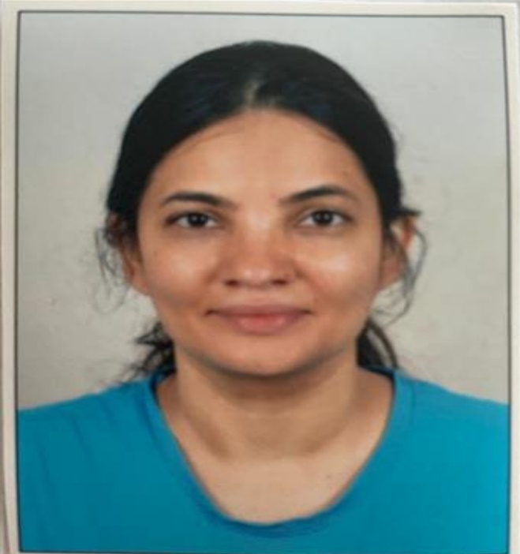
Team of SIG Female Genital Dermatoses

Slide 4
IADVL Academy 2022
Dr Lalit Gupta
Chairperson
Dr Rashmi Jindal
Convener

Slide 5
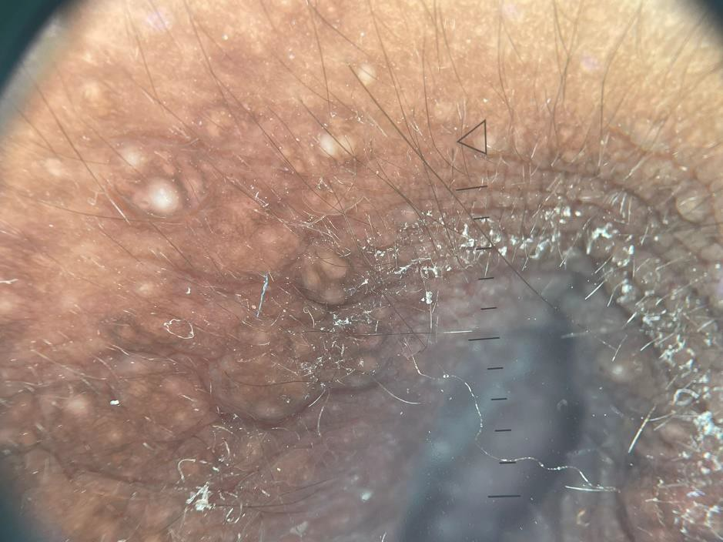
DR SMITHA PRABHU S, KMC, MANIPAL
Dear colleagues
I will be posting a couple of relatively common cases that I encountered in my practice...
Nothing very spectacular. Most will be like memory boosters.
Case 1:
This 16 year old girl, I saw a few weeks ago, she was mentally subnormal , and was brought by her mother who noticed her scratching the genital area every
now and then. She denied being molested ( though we couldnt ask outrightly, and we tried to be subtle about it). Duration was not known, mother
didnt know, patient didnt respond . Dermoscopy was done, she refused biopsy.. attaching the clinical pictures herewith. Would welcome discussion.
Intense pruritus and the lesion morphology both point in favor of vulvar Syringoma

Slide 6
Have seen only one case so far who rescinded orly to topical steroids and developed irritant dermatitis to topical tretinoin. Thereafter, she got lost to follow up.
Cryotherapy may be tried.
My diagnosis too was vulvar syringoma, and she was given cetirizine tablet 10 mg in the evening. She hasnt come for follow up. Vulvar syringoma is known to be pruritic, esp during menstruation, on sweat inducing activities.... Best possible treatment is electrofulguration, or laser ablation. Tried to search literature for medical therapy - topical retinoids or tacrolimus, but invariably , excision or ablation is the modality of choice.
Interestingly other forms described are - giant syringoma, milia like , and lichenoid variety.
Case 2:
37 year old lady, known case of AML on chemotherapy , 17 cycles
given, developed initially itchy genital swelling , which later became painful of 15 days duration. Has been given 2 courses of antibiotics- IV cefotaxim and Meropenem, and topical ketoconazole cream with temporary
improvement, and later recurrence. Examination revealed tender indurated edematous swelling involving left labia majora and inner thigh, mostly intact ,
with few areas of erosion and pseudovesiculation. Inguinal LN were bilateral palpable and tender.
What may be the diagnosis ?

Slide 7
What investigations may be required?

Slide 8
Vulvar lymphangiectasia was one of the differentials

Slide 9
But in view of extreme tenderness and pain, and chemo
induced immunsuppression also considered abscess formation with fibrosis, And Cutaneous metastasis was another Differential
Biopsy was done .
I don't have the photomicrograph, but this is the report.
And also attaching the follow up pic of the patient after 2 weeks of IV and oral Amoxclav and continuing topical luliconazole

Slide 10
Dr Pragya Nair , Professor , Pramukhswami medical college , Gujarat . Please find a case for further discussion
CASE 3
A 44 year old female presented with elevated lesions over genitals since 5 years. The patient was relatively asymptomatic before 5 years after which she developed blackish elevated lesions over genitals .The lesions gradually increased in number but remained the same in size.
The lesions caused discomfort on movement. N/C/O burning/ itching/ pain over lesions / or any vaginal discharge
N/H/O any blood transfusion/ tattooing/ extra marital sexual exposure
N/H/O similar complaints in partner
H/O last sexual exposure with husband before 10 days
The patient took various sessions of liquid nitrogen but did not experience any relief .
Please give your clinical differentials
There was no history of bleeding from the lesions , .HIV done was non reactive
I kept angiokeratoma and seborrheic
keratosis as differentials before doing dermatoscopy and histopathology .

Slide 11
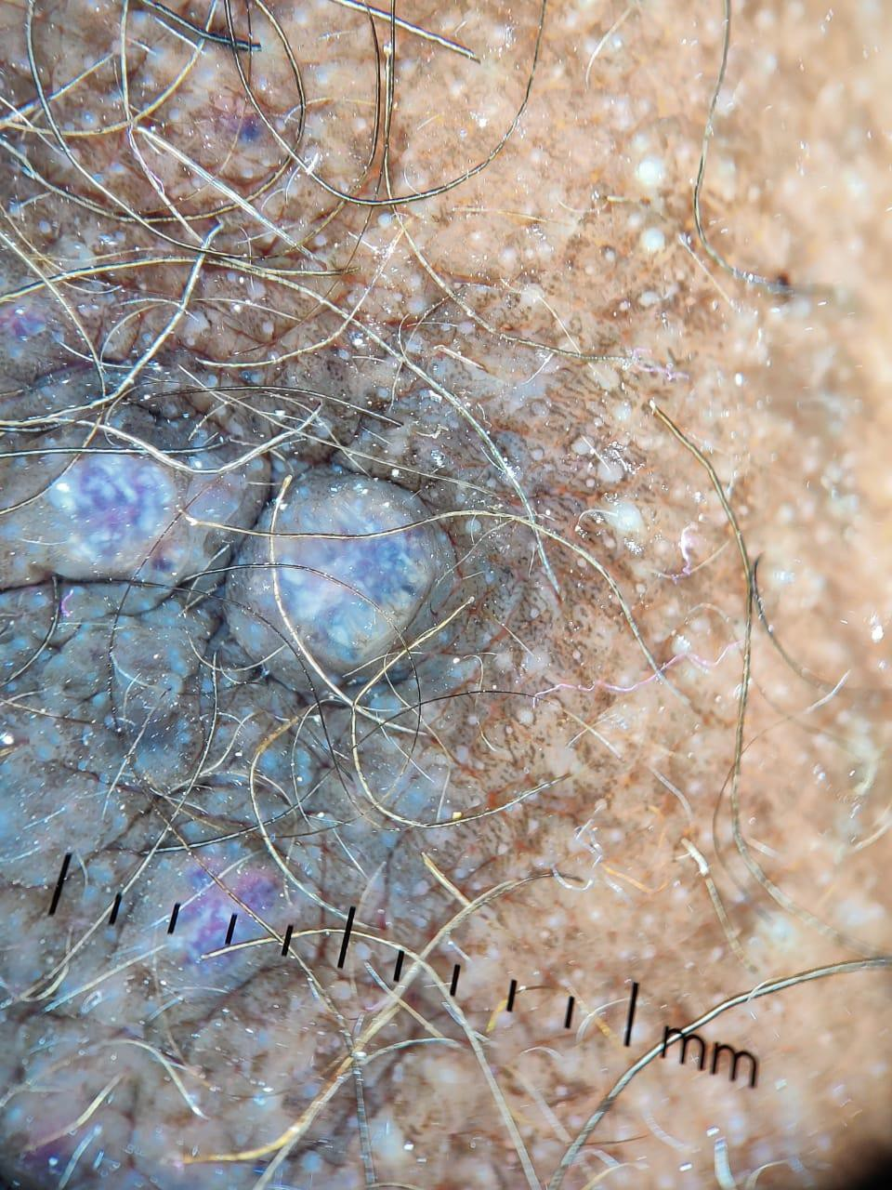
Patients Last delivery was before 15 year. Had H/O hysterectomy before 5 years for dysfunctional uterine bleeding
and H/O endoscopy guided mucosal resection of gastric polyp before 7 years.
Please find the dermatoscopic and histopathological images of above patient . Regards
Dr Pragya Nair

Slide 12
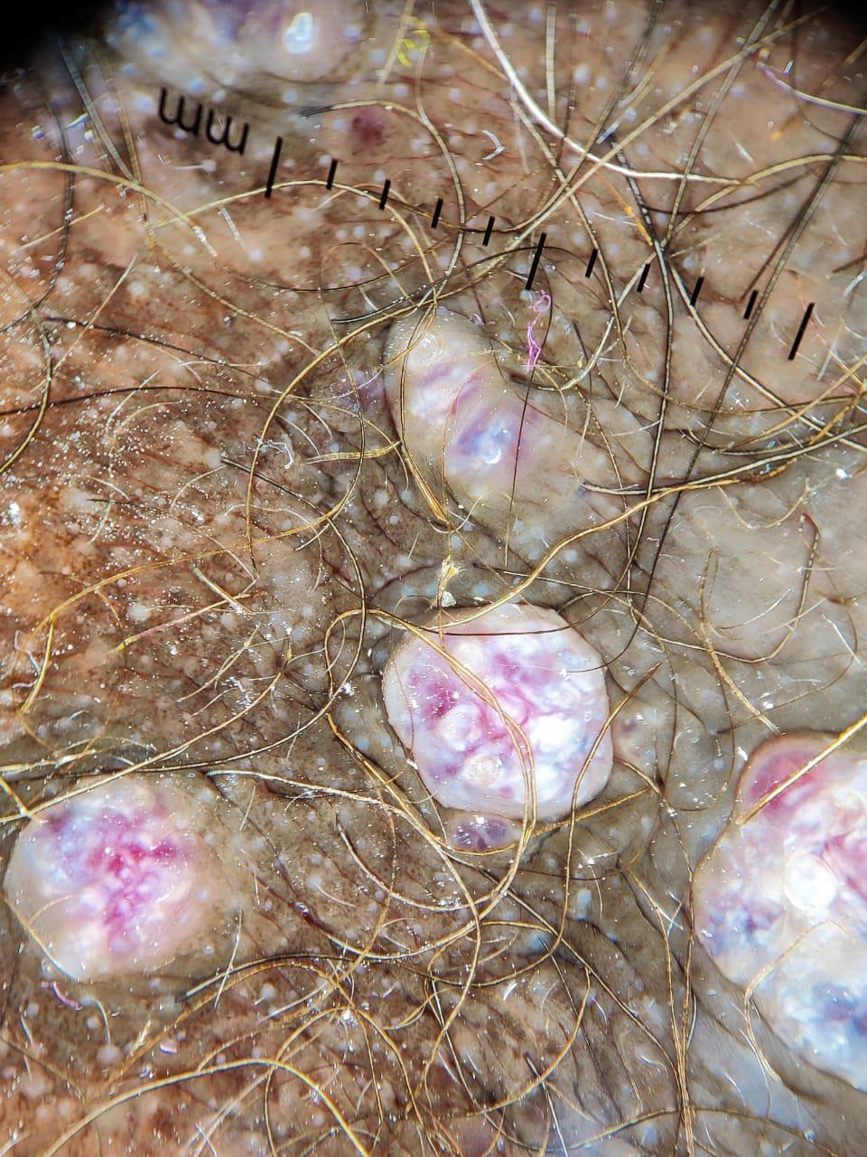

Slide 13
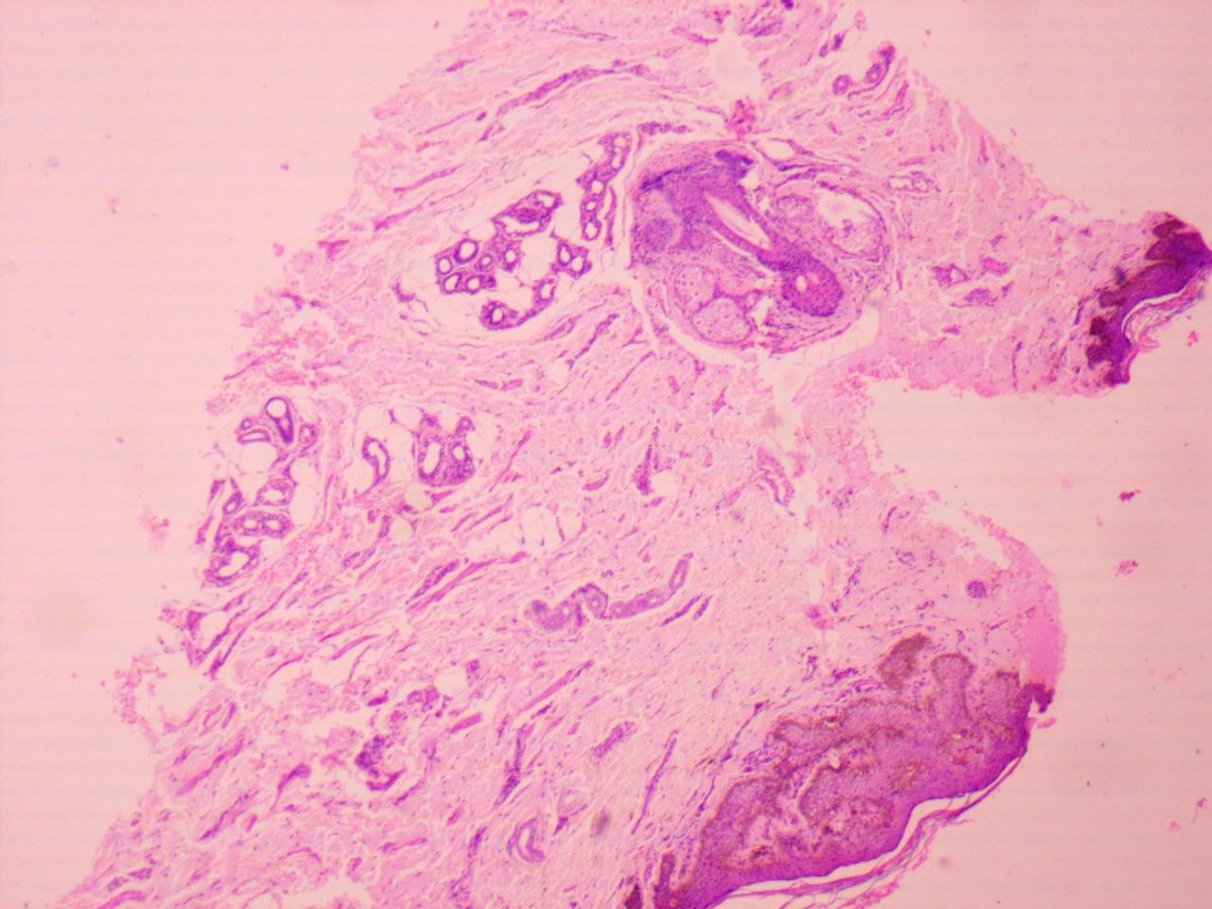
Dermatoscopy showed well-demarcated, round lacunae and a whitish veil which is characteristic of angiokeratoma.
Histopathogy showed focal acanthosis and hyperkeratosis in epidermis while papillary dermis shows ectatic, congested vascular spaces extending into dermis.Attached is image with higher magnification
Dermoscopy helps to differentiate it from
PG which reveals whitish veils but lacks the red-blue lacunae.
Bowenoid papulosis shows brown to gray structureless areas and glomerular or hairpin vessels in a clustered and linear arrangement.
Its prevelance is underestimated -affects 0.01 % of women with pain, burning
sensation, dyspareunia, post-coital bleeding, soreness, pruritus , persistent and copious blood tinged vaginal discharge, dysuria.Presents with

Slide 14
Bright red erythema-glazed appearance , erosions with well demarcated white reticular rim (Wickham striae)
Symmetrical and bilateral - affects labia majora and introitus.
Seen with other forms of lichen planus / auto-immune diseases/drug exposure.
Differentials
Extra mamillary Paget's disease
Crohn disease - Erosions of the oral cavity, vulva or perineum, or anus, and present years before any bowel findings.
Autoimmune bullous diseases - differentiated by immunofluorescence studies
Behcet syndrome
Erythema multiforme
Stevens-Johnson syndrome
Lichen sclerosus - rarely affects the vagina or oral mucosa.
Plasma cell vulvitis, vulvar intraepithelial neoplasm, and atrophic vaginitis.
Dermatoscopy has characterstic findings
Vascular findings

Slide 15
Thick linear, irregular vessels, including hairpin vessels
No dotted vessels
Diffuse arrangement throughout lesions
Radial or parallel arrangement at the periphery of lesions Sea-anemone pattern
Non vascular findings
Wickham striae, with the following configuration: Reticular. Homogeneous
,Rounded-globular, Annular, Radial streaming, Dots/“starry sky”, Gray-white and/or blue-white veil
Dull or intense red background
Blue-gray dots/globules Peppering pigment Comedo-like openings
Attached is the image after 3 months of treatment considering as erosive lichen planus .
Treatment given
Tab prednisolone 30 mg for -7days followed by 20mg for 7 days , 10mg 7 days and 5 mg for 7days - total 1 month.
Clobetasone propionate ( 0.05%) once daily for 2 months followed by alternate days continuing . Tacrolimus ( 0.01%)cream once daily for 1

Slide 16
month followed by alternate days -1 month and twice a week still continuing .

Slide 17
Dr. Nina Madnani, MUMBAI
CASE 4
I am Dr Madnani, Member of the SIG FGD group, and I thank Dr Smitha and Dr Pragya for taking this forward this discussion, and giving me this opportunity. A 40 yr old female came to me with a 5 yr history of an itchy skin rash on the groins, vulva and perianal areas.
She had a H/o asthama in childhood, and also eczema for a short period during her teens.
Both had been treated with allopathic medicines, and she felt she had been "cured".
Over the last 3 yrs she had been diagnosed with CIU via another dermatologist and was on atarax 25 3 times a day, which seemed to controlher urticaria, but was not ontrolling the vulvar itch.
She had been administered over the years several courses of fluconazole, clindamycin, and topical steroids with no relief.
She was non-diabetic and had no comorbidities.
She had 2 daughters (twins), 12 yrs of age, super intelligent. Her clinical images are attached.
WHAT IS YOUR DIAGNOSIS?
The patient also had perianal involvement (image attached) as well as inframammary and axillary involvement with similar lesions.
No mucosal involvement.

Slide 18
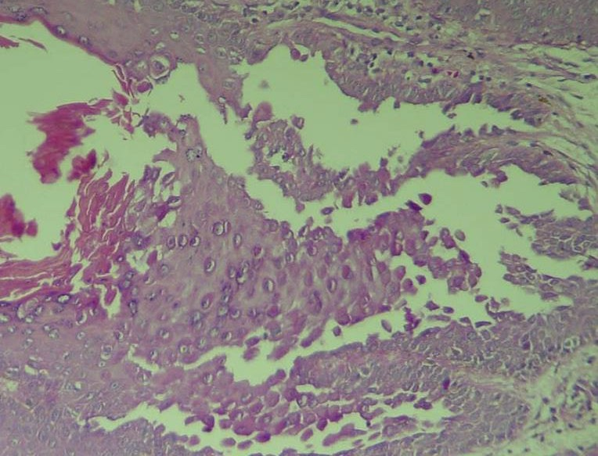
Pruritis was intense with no relief with atarax 25 mg tds (which she was taking
for her CIU.).A biopsy was performed, and the biopsy image uploaded. What is yourdiagnosis? How would you manage?
Here is what I did:

Slide 19
When the patient came to me she was already on topical Cs and had CIU, and had lots of striae (look at images)
Doxycycline was started at a bid dose for 6 weeks with no relief so she was then
Started her on Folitrax 10mg for her CIU which came under control in 4 months
. The folitrax dose was raised to 15 mg but had no effect on her hailey hailey. Acetretin could not be given as she was sexually active, and was already on a drug straining her liver.
Tacrolimus and pimecrolimus gave her severe itching and burning so was discontinued.
The literature of success of low dose naltrexone was exciting so decided to try it on my patient.
Problem: Naltrexone is available in 50 mg tablets and the dose recommended is 3mg to 4.5 mg or higher if patient tolerates. How do you divide a 50mg tab into 3mg sections.
So a compounder was contacted and he compounded capsules of 3 mg. The patient was prescribed 3mg HS for 6 weeks. No relief, so 4.5 mg capsules compounded and patient took them but she started developing headaches but we convinced her for another 6 weeks. NO RELIEF. So we discontinued the Naltrexone.
The patient was now willing for laser ablation as the area was so extensive. As a last resort, I discussed botulinum toxin injections with her.
She was willing.
So under topical anaesthesia, using the dilution we use for hyperhydrosis, I gave her at multiple sites including the peri anal area. After the first session,

Slide 20
her itch was better. After the second session, the itch disappeared and her lesions starting healing. (Pics uploaded)
Dr.Nina Madnani
Dr. Dhanashree Bhide CASE 5
Case summary
46 year old married lady(P2L2A1) with painful ulcerative lesions in vulvar area since 2017
Diagnosed and treated as recurrent genital herpes initially Was unhappy with the outcome and then went to 2 more dermatologists who treated her with
antibiotics and antifungals without satisfactory results
Progress
As she kept on having symptoms she went to yet another dermatologist in March 18 - was diagnosed as Behcet's disease
Investigations :HIV ,VDRL and IgM and IgG for HSV I and II -All were negative Biopsy was done (April 2018)which showed
vasculitis(?Bahcet’s)-Details not available
Treated in the following manner for 6 months
March 18-August 18 Was put on Colchicine 0.5 mg bd ,Valacyclovir on and off and antibiotics as per pus culture and sensitivity

Slide 21
In August Prednisolone 20 mg was added
Sept 2018 Went to 5th Dermat Diagnosis of HS was considered and Azathioprine 100 mg was added
Patient noticed ﬂare and oedema of vulva and AZA was discontinuedPatient returned back to Dermat with large, tender ulcer with yellowish crusts and oedema on right labia majora
What is your differential diagnosis and how will you proceed with this case which is already seen by 6 renowned and senior dermatologists
Please go through the HPE report and suggest the possible diagnosis

Slide 22
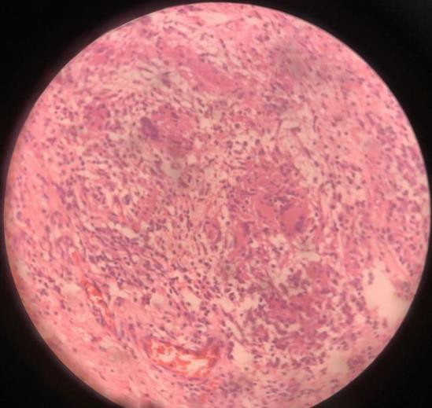
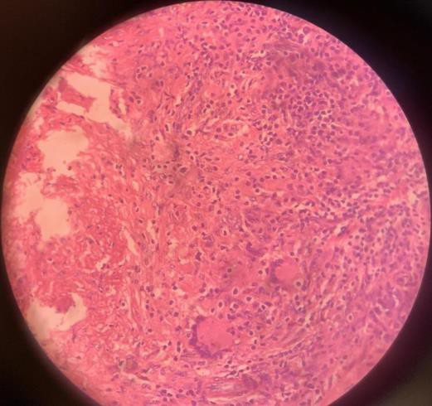
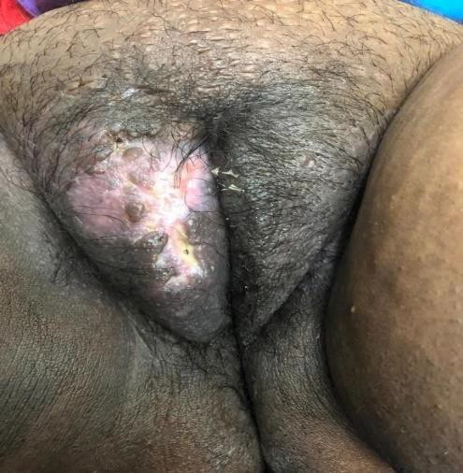
Caseating granulomas with Langhans giant cells and inﬁltrate with predominance of lymphocytes (plasma cells and epitheloid cells were also present in the inﬁltrate )
Sept 18
Oct 18
Feb 19
Results after AKT (given for 1 year)

Slide 23
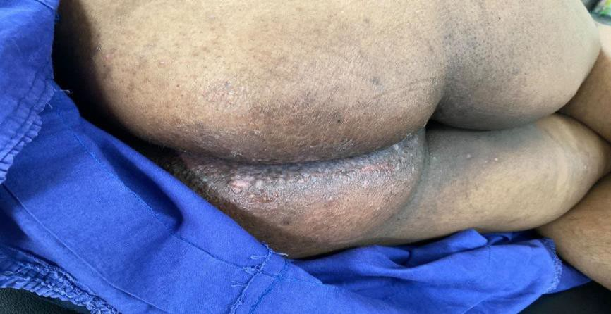
Within few weeks of stopping AKT tiny painful ulcers reappeared
Patient went back to Dermat 1 Diagnosis of genital aphthae was considered Topical steroids were given for application and symptomatic treatment was added
Not much improvement with recurring episodes of painful ulcers
During Nov 2019-March 2020 was treated with short courses of antibiotics and antifungals.
As the lesions showed different morphology a repeat biopsy was planned
March 2020-
Repeat biopsy was done
Biopsy Report was as follows

Slide 24
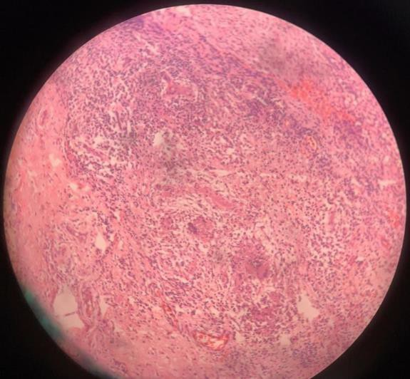
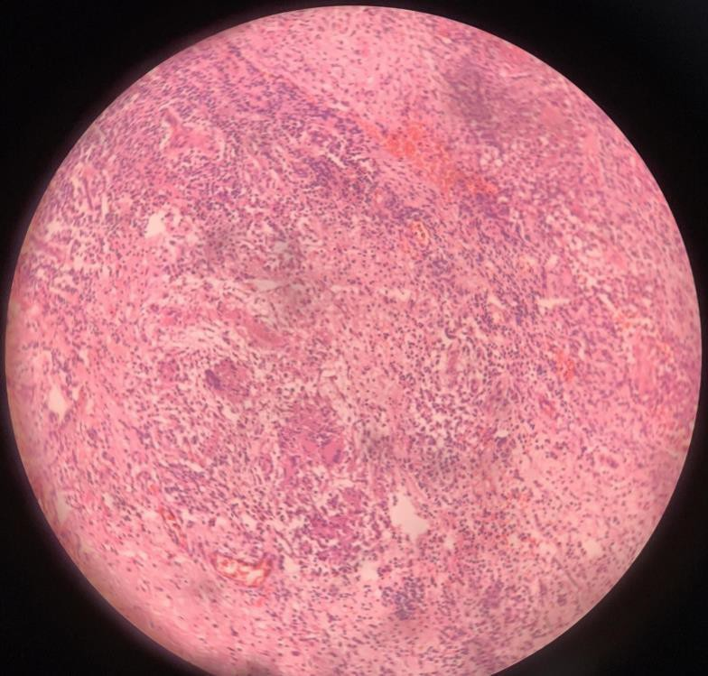
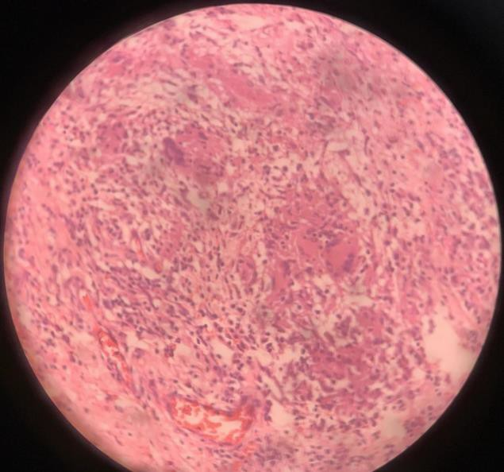
Dermis and subcutis showing mononuclear inﬁltrate with proliferating capillaries,foreign body giant cells and granuloma with epithelioid cells and langhans giant cells without caseation necrosis
After clinicopathological correlation what will be your conclusion?
We considered 2 possibilities Recurrence of TB
Other granulomatous condition with non caseating granulomas Opinion of chest physician was sought
Further Evaluation as suggested by chest Physician-

Slide 25
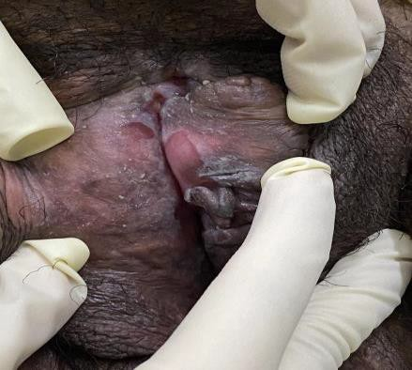
ZN stain ,Genexpert studies, AFB culture and Mantoux were PAS was negative
TB and deep fungal infection was ruled out
negative
Dilemma Continued
On clinical grounds-(small abscesses with discharging sinuses )diagnosis of HS was considered and in April 2020 Acitretin 25 mg was added
Genital lesions showed only partial improvement and pain and discomfort continued
In addition few but few lichenoid lesions appeared on forearm and new ulcerative lesions were noticed on labia minora
Referred for second opinion to senior dermat in Aug 2020 He considered clinical diagnosis of ulcerative LP with superadded fungal
Steroid minipulse
,topical steroids
and itraconazole was added
Showed rapid response and healing of lesions

Slide 26
14 th September 2020 Results of Itraconazole Steroid minipulse Topical steroids
Sept 2020-Lesions healed well

Slide 27
Unfortunately this time also the response could not be maintained and some new morphological type of lesions appeared And why would lichen planus show granulomas on HPE ?
So we were dealing with something else Let us see in our next photograph
Unfortunately this time also the response could not be maintained and some new morphological type of lesions appeared And why would lichen planus show granulomas on HPE ?
So we were dealing with something else Let us see in our next photograph
Colonoscopy with Biopsy-No granulomas Mild chronic ileitis with ulceration Fecal Calprotectin -High 141.7 ASCA IgA was done -50 high
Old skin biopsy was re evaluated and noncaseating perivascular granulomas withoutcaseation-phenomenon called granulomatous perivasculitis was noticed

Slide 28
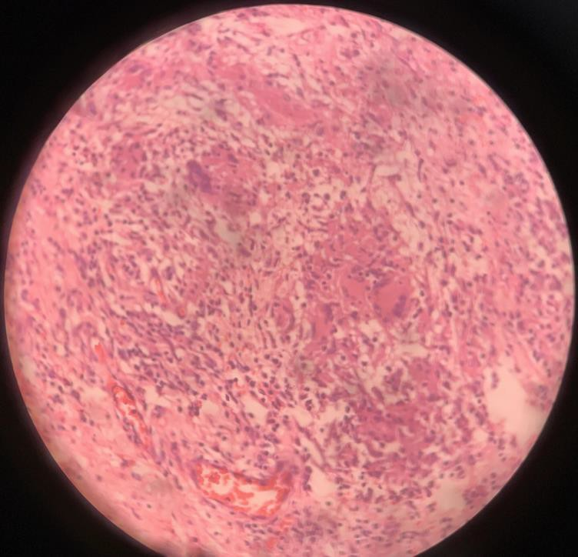
In July 2021 MTX 10 mg weekly and Wysolone 20 mg was added Was better from July to Oct
Again new lesions started appearing hence cyclosporine was added in a dose on 3mgm/kg with improvement but recurrence on tapering
Present Status

Slide 29
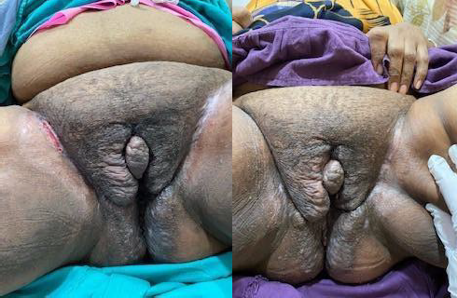
Pre Cyclosporine
Post Cyclosporine
What I Learnt
Painful recurrent vulvar ulcers are not always genital herpes and should be evaluated in depth for HS ,PG and metastatic Crohn’s disease with high index of suspicioN
Any ulcer in lower body should be evaluated for lower GI involvement
All granulomas are not tubercular

Slide 30
Metastatic Crohn’s in absence of GI symptoms is rare and it can mimic many vulvar dermatoses .This can mislead a treating physician and lead to delay in diagnosis
Confusion arises because many granulomatous conditions have identical HPE and sometimes single pathology can produce varied histological features
What is metastatic Crohn’s Disease
Cutaneous lesions in areas non contiguous to GIT
Most common area of involvement is vulva,penis,legs,trunk and face
Various morphologies can be-Knife cut ulcers,erythematous painful lesions on extremities,violaceous perifollicular papules,lichenoid papules on neck and LL
,erythematous plaques on face and extremities
Skin lesions in metastatic Crohn’s disease may present during ,after or rarely before the presence of inﬂammatory bowel disease
In 22-44% cases of intestinal Crohn’s disease have cutaneous symptoms in following manner
Anal tags usually a bunch are often characteristic like knife cut ulcers.
Search for knife cut ulcers in unusual areas like infra abdominal folds. Inter crural folds, and sometimes even under heavy breasts.
Often a simple drug like metronidazole works very well but long term use is not tolerated by the patients. One of my patients developed a peripheral neuritis type symptoms. Also warm about alcohol whilst taking metronidazole. Azathioprine is one of the drugs used but response happens after several months.

Slide 31
Chrohn is a chronic disease so long term treatment. Often Crohn and HS can coexist.
Asymmetrical vulvar edema with ulcers, think of crohns as a dd Warm regards Nina Madnani
Dr Nisha Chaturvedi, consultant dermatologist and a member of SIG FGD group.
CASE 6
I would like to thank Dr Smitha maam and Dr Pragya maam for giving me this opportunity.It is going to be a pleasure to learn and discuss with all of you’ll.
A 3.5 year old girl was brought to the clinic with chronic constipation and mild itching on the perianal and vulvar area since 6 months. She was treated with some topical anti fungal creams by her paediatrician. There was no history of similar lesions else where on the body. Her clinical images are attached. What is the diagnosis and how would you manage this case?

Slide 32
There was no history of any application or any sexual abuse
Yes , even I was wondering what could be the cause of erythema..
Thinking as a perianal dermatitis , I counselled mother about genital hygiene
and cleaning , and gave topical antibiotics before starting treatment of her hypopigmentation
The child was as asked to follow up after a week , but came after a month. Attaching the follow up pics .
I would like everyone’s opinion regarding the management of the same . Thank you
The clinical diagnosis was Lichen Sclerosus ( earlier called as LS et A ).
I would like to know , how does everyone manage childhood lichen sclerosus in practice by addressing following questions,
The type of corticosteroids use for treatment ?
how long to continue the treatment?
does one shift to calcineurin inhibitors?
is there post puberty remission or need follow up for long term ?
do children have same complications as in adults ?

Slide 33
Kindly share your experience Thank you
Regards,
Dr Nisha Chaturvedi DNB, MD, DDVL
Dr Sweta Rambhia , Mumbai CASE 7
62-year-old married female presented with itchy pigmented skin lesions over the genital area of 6 months duration.
Itching was mild in nature, intermittent, and more in daytime. The lesions gradually increased in number and size since then. There was no history suggestive of any immunosuppressed condition or history of long-term drug intake.
On examination, multiple, well defined, papules greyish black of varying size with verrucous to smooth surface distributed bilateraly over labia majora and vulva .(Fig 1)

Slide 34
Venereal disease research laboratory test and HIV screening test were nonreactive . Complete blood count and random blood sugar levels were within normal limits.
Biopsy shows moderate epidermal hyperplasia with thickening and confluence of rete ridges. The surface of lesion is mamillated. The thickened epidermis shows mild to moderate nuclear pleomorphism. The epidermal keratinocytes show haphazard arrangement and crowding in foci throughout the epidermal thickness. Scattered mitotic figures (normal and abnormal) are seen above the basal layer. The granular layer and corneal layers are slightly thickened

Slide 35
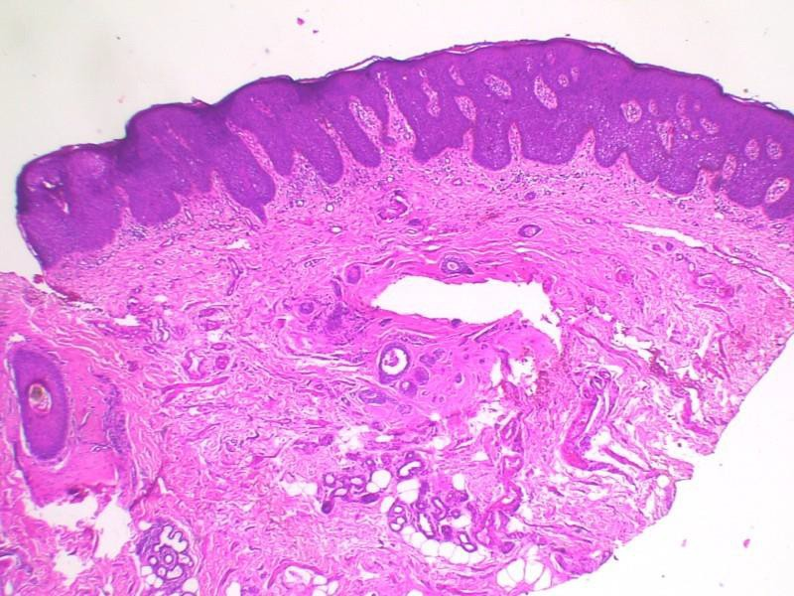
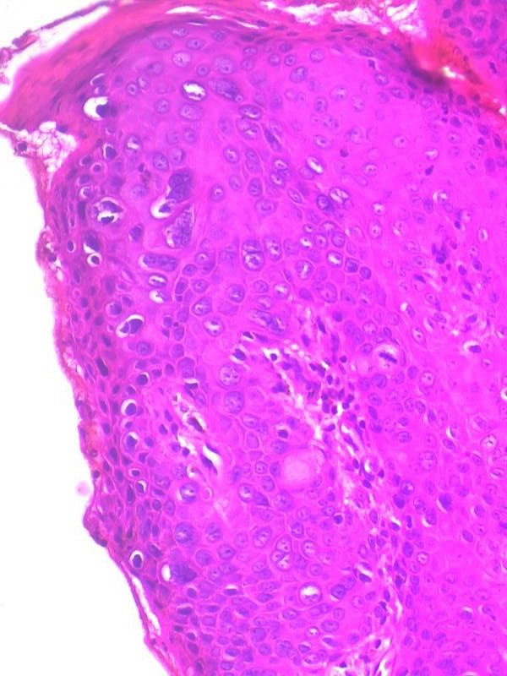
The thickened epidermis shows mild to moderate nuclear pleomorphism. Scattered mitotic figures (normal and abnormal) are seen above the basal layer.
•

Slide 36
Patient was treated with topical 5-fluorouracil (5-FU) 1 percent cream
Patient responded after few weeks, the majority of the lesions showed excellent response with complete healing.
Bowenoid papulosis was first described by Kopf and Bart in 1977.
Bowenoid papulosis (BP) clinically presents as multicentric violaceous or erythematous papules along the vulva, perineum, or intertriginous skin
folds, although solitary lesions have on rare occasion been noted in the genitalia.
The most frequent localization in women is the vaginal labia. It presents with single or, more often, multiple isolated or grouped
hyperpigmented, skin-colored or violaceous, flat, verrucous
asymptomatic papules of a few millimeters to several centimeters in size.

Slide 37
It is a sexually transmitted precancerous skin condition of the genital area.
It is a HPV-induced intraepithelial dysplasia (low-grade in situ
carcinoma) mainly associated with HPV 16, but other types have also been found (HPV 18 and HPV 33).
Histopathologically, it is characterized by koilocytosis, enlarged polymorphic and hyperchromatic nuclei, and abnormal mitosis and hyper- or parakeratosis with a collection of melanin of various amount.
Dermoscopy: The most common dermoscopic findings of BP in studies published as case reports and small case series findings include brown and gray dot structures with linear extension and glomerular and dotted vascular structures.
Prognosis : Though this condition is considered to be a low-grade in situ carcinoma, the prognosis is good in the majority of patients. Lesions may
sometimes spontaneously regress. Evolution into an invasive squamous cell carcinoma more often occurs in immunosuppressed patients.
Differential diagnosis include Anogenital warts, seborrheic keratosis,
Bowen’s disease, pigmented basal cell carcinoma, and dermal melanocytic nevus.
Treatment options include topical agents, such as 5-fluorouracil, imiquimod, podophyllin or cidofovir, and surgical modalities, such as excision, electrocautery, CO2 laser, cryosurgery, and photodynamic therapy. Interferon and topical or systemic retinoids have also been tried

Slide 38
Dr Vinitha Gopalakrishnan, consultant Dermatologist ,VPSLakeshore Hospital , Cochin, Kerala.
CASE 8
I am extremely thankful to the entire SIG
FGD and ACAAD groups for the opportunity given.
A 62 yr old post menopausal female ,who i a k/c/o Liver transplant 2 yrs back, presented to Dermatology OP with complaints of vulal itching and pain o 1 yr duration.She received multiple intermittent courses of topical and systemic antifungals over the last 1 year.She is a
diabetic and hypertensive for the past 20 yrs and is on regular
medications.Shes on T.Cyclosporine 100 mg BD, T.MMF 500mg BD and T.Lacosamide
O/E: Macerated and eroded areas noted over labia.A nodular hard outgrowth with saling over Rt labia majus seen
Let's discuss the DDs and approach to such a case

Slide 39
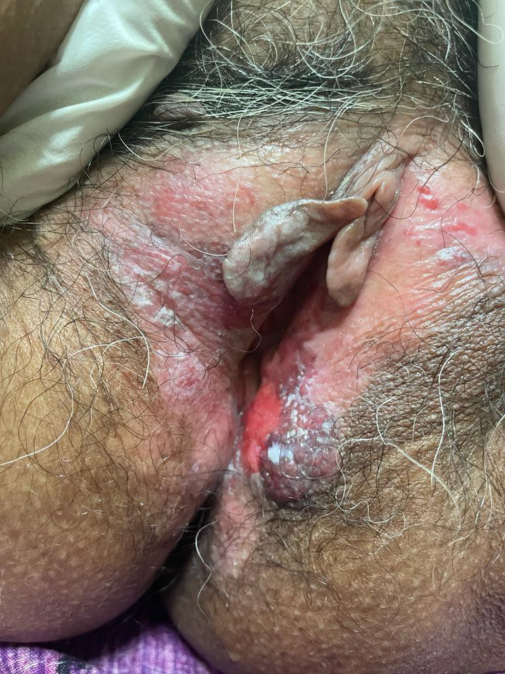
The case was taken up by the Surgical oncology team and modified radical vulvectomy was performed.
Post vulvectomy Histopathology showed:Pics attached
Extensive involvement of epidermis by ovoid large cells with large ovoid nuclei with pale to coarse chromatin,variably prominent nuclei and scanty to moderate amount of cytoplasm suggestive of Paget's disease.Cells are seen singly as well as in aggregates and glandular
form.Section from indurated area show invasive component with similar smaller foci in other areas.Mitotic figures seen.Tumor extends to subcutaneous tissue .Perineural and perivascular invasion seen
Final impression:Invasive Paget's disease of vulva

Slide 40
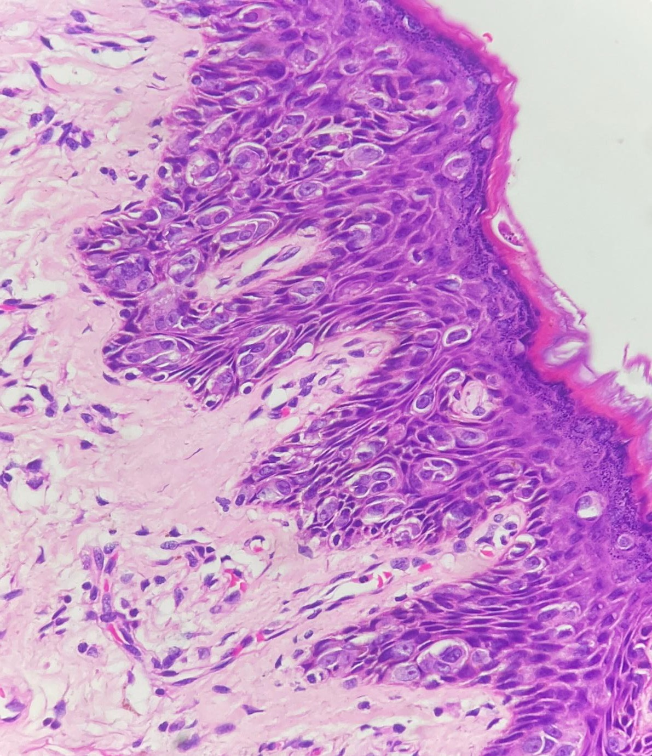

Slide 41
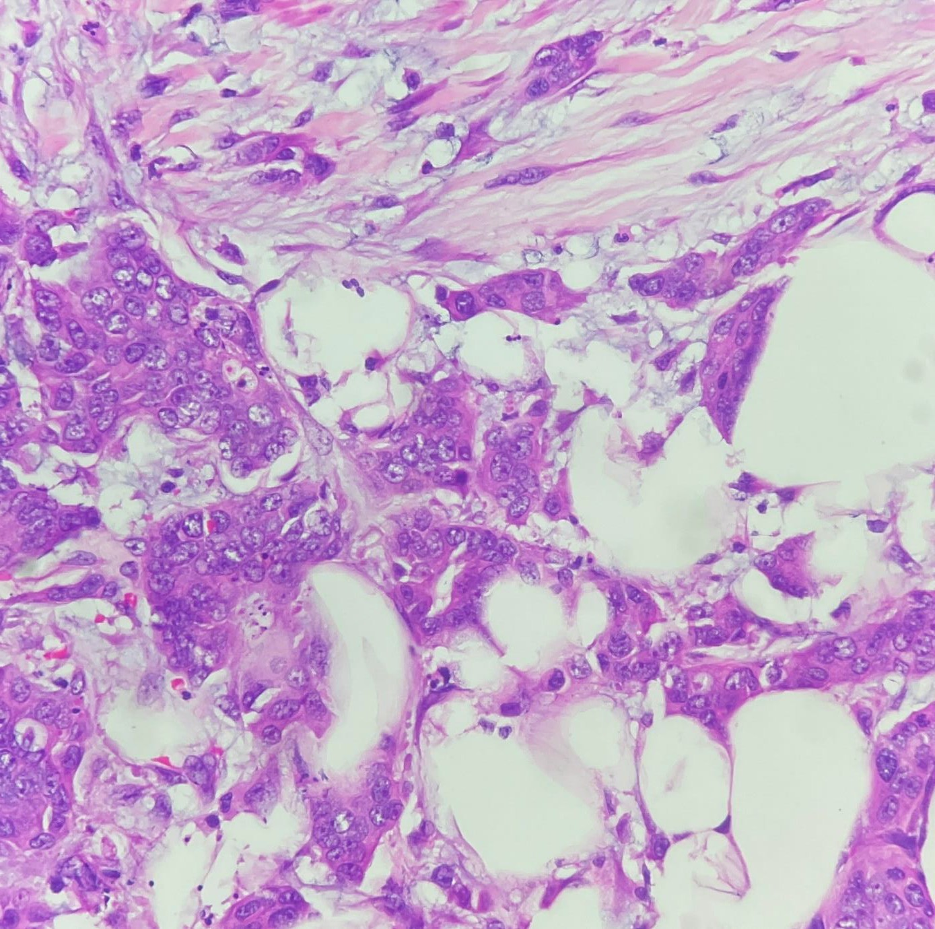
Dr Pragya Nair
Please find a case for the discussion from SIG FGD .
Case -9
A 49 year old female was referred by gynecologist with reddish lesions over genital , itching , burning and discharge from it . She had these lesions since

Slide 42
almost 2-3 years . Before 6 months consulted gynecologist somewhere outside , who took excision biopsy from a growth over that area . The reports not available with the patient .
Presently also gynecologist took the biopsy again 2-3 days back at our institute and than referred to us. Clinical photos are attached . I did the dermatoscopy and waited for the reports of biopsy .
Please give your expert opinion .

Slide 43
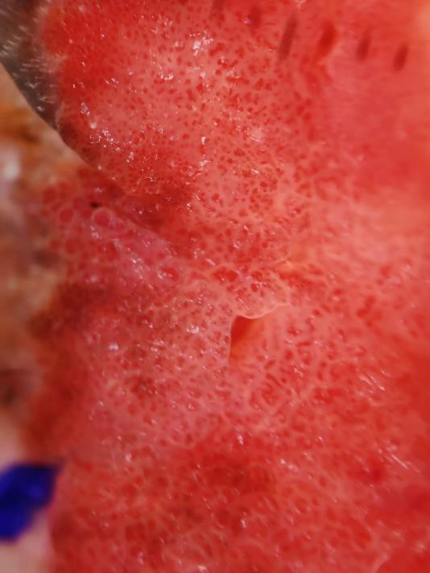
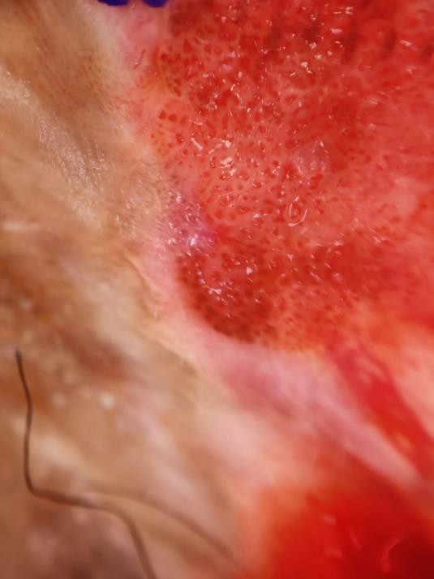
Dermoscopy – Red dots, vascular structures
Biopsy report
Histopathology showed severely dysplastic squamous epithelium with moderate to severe pleomorphic cells containing round to oval hyperchromatic nuclei and scant cytoplasm.
Atypical mitosis as well as individual cell keratinization was noted. The stroma showed mild lymphoplasmacytic inflammation and areas of haemorrhage.
There was no definitve stromal invasion. Histopathological diagnosis: VIN: high grade.
I gave her imiquimod 5% daily application for 2 months, but there was no improvement. 5 FU was tried, but patient couldn’t tolerate due to severe irritation.
The second biopsy , which we did later showed SCC.
Currently, the patient is on radiotherapy. She is yet to come for a follow-up.

Slide 44
Herein, we end the cases from SIG FGD. Hope we could offer a varying array of cases
****************************************************************

